Slide 1
RadEval: A framework for radiology text evaluation
(EMNLP 2025)
2026.07.28
Chudhary Shoaib Ahmad
Department of Computer Science
Notes:
The main focus of this paper is not generating radiology reports, but how we can properly evaluate AI-generated radiology reports.
The authors propose RadEval, which brings many existing radiology evaluation metrics into one standardized framework.

Slide 2
Contents
Introduction
Existing Radiology Report Metrics
RadEval Framework
Benchmarking
RadEvalBERTScore
RadEval Expert Dataset
Conclusion & Limitation
Notes:
I will first explain why radiology report evaluation is difficult. Then I will briefly introduce the existing evaluation metrics.
After that, I will explain the RadEval framework, the datasets and baseline models used for benchmarking, RadEvalBERTScore, and the expert radiologist evaluation.
Finally, I will discuss the main results, the refined GREEN metric, conclusion, and limitations.

Slide 3


Introduction
Why Radiology Report Evaluation is difficult?
  Radiology reports must be clinically correct, not just fluent English.
  RRG evaluation must check clinical factuality, uncertainty, terminology, and diagnostic relevance.
  A metric can over-reward word overlap while missing negation, severity, laterality, or temporal mistakes.
  The paper's core question: which automatic metrics align with radiologist judgments?
Good Grammar
$$≠$$
Correct Medicine
Same Words
Same meaning
Different words can mean same finding
Notes:
The first problem is that evaluating a radiology report is very different from evaluating normal generated text.
A report can be grammatically perfect but still contain a serious medical error. Therefore, evaluation has to consider not only language quality, but also clinical factuality, terminology, uncertainty, severity, location, and diagnostic relevance.
For example, “No pleural effusion” and “Small pleural effusion” have many of the same words, but clinically they mean opposite things.
So, the central question of this paper is: Which automatic evaluation metrics actually agree with radiologists?

Slide 4
Introduction
What RadEval contributes?
  RadEval is a framework, not a report generation model.
    Unified codebase: Many radiology text metrics under one open-source interface
    Metric refinements: Corrected/standardized implementations for fairer scores
    Expert dataset: Radiologist-labeled clinically significant and insignificant errors
    Baselines + tests: Published model predictions and statistical significance tools
  RadEval makes evaluation easier to run, easier to compare, and easier to reproduce.
Notes:
RadEval is important to understand as an evaluation framework, not a report-generation model.
Its first contribution is a unified open-source codebase containing many radiology evaluation metrics.
Second, the authors correct and standardize implementations of several existing metrics.
Third, they provide an expert dataset where radiologists annotate clinically significant and insignificant errors.
Finally, they include baseline model predictions and statistical testing tools.
Overall, the aim is to make radiology report evaluation easier to reproduce and compare across studies

Slide 5
Introduction
Existing metric landscape: four generations
  The progression is not "old bad, new perfect"
  Each metric family measures a different slice of report quality.
Lexical
BLEU, ROUGE METEOR, CIDEr
Word/n-gram overlap
Semantic
BERTScore
Embedding similarity
Clinical
CheXbert, RadGraph RaTEScore, SRR-BERT
Findings, entities, relations
LLM-based
GREEN, RadFact FineRadScore
Reason over clinical errors
Notes:
The authors organize the history of radiology report evaluation roughly into four groups.
First are lexical metrics, such as BLEU and ROUGE, which mainly compare words and n-grams.
Then semantic metrics such as BERTScore use embeddings to compare meaning.
Clinical metrics such as CheXbert, RadGraph, and RaTEScore compare medical findings, entities, or relations.
Finally, newer LLM-based metrics such as GREEN try to reason directly about clinical errors.
An important point is that this progression does not mean the older metrics are useless. Each family measures a different aspect of report quality.

Slide 6
Existing Radiology Report Metrics
Lexical overlap metrics
  Easy baseline but week clinically understanding.
  BLEU/ROUGE compare n-gram precision and recall.
  BERTScore improves lexical matching by using contextual embeddings.
  Core weakness: similarity is not the same as clinical correctness.
Rerference Report
“No pleural Effusion”
Generated Report
“Small Pleural Effusion”
High words overlap but clinically wrong.
Notes:
The earliest evaluation methods were BLEU and ROUGE. These are simple because they compare word or n-gram overlap between the generated report and reference report.
BERTScore improves this by using contextual embeddings, so different wording with similar meaning can still receive credit.
But the main weakness remains: textual similarity is not the same as clinical correctness.
In this example, “No pleural effusion” and “Small pleural effusion” share many words, but one says the disease is absent and the other says it is present.

Slide 7
Existing Radiology Report Metrics
Clinical concept-based metrics
  These metrics extract medical concepts before comparing reports.
  Benefit: More domain-specific than BLEU/ROUGE.
  Limitation: Still depends on extractors, parsers, labels, and matching rules.
F1CheXbert
Extracts 14 CheXpert categories then computes F1
SRR-BERT
Expands the label space to 55 labels
F1RadGraph
Turns reports into entities and relations
RaTEScore
Entity matching with synonyms and diagnostic importance
Temporal Entity F1
Checks improved, worsened, stable, etc.
Notes:
To make evaluation more medically meaningful, researchers introduced clinical concept-based metrics.
F1CheXbert extracts 14 CheXpert categories and compares them.
SRR-BERT expands this label space to 55 labels.
F1RadGraph represents reports using clinical entities and their relationships.
RaTEScore performs entity matching while considering synonyms and diagnostic importance.
Temporal Entity F1 specifically evaluates temporal information such as improved, worsened, or stable.
These metrics are more domain-specific, but their performance can depend on the underlying labeler, parser, or matching rules.

Slide 8
Existing Radiology Report Metrics
Composite and LLM-based metrics
  Newer metrics either combine several signals or ask an LLM to judge clinical errors.
  Composite metrics can correlate better with experts but may be harder to interpret.
  LLM-based metrics are flexible and often clinically aligned, but can be costly, inconsistent, or API-dependent.
  RadEval standardizes access and supports lightweight/open alternatives.
RadCliQ
BLEU + BERTScore + CheXbert similarity + F1RadGraph
Learns a combined score from radiologist labeled error counts.
GREEN and related LLM evaluators
Read reference + generated reports then identify clinical errors and summaries.
Notes:
The next generation either combines multiple metrics or uses LLMs directly.
RadCliQ combines BLEU, BERTScore, CheXbert similarity, and RadGraph using a learned linear model trained on radiologist error counts.
GREEN takes a different approach. It uses an LLM to read the generated and reference reports and identify clinical errors.
LLM-based metrics are flexible and often align better with expert judgment, but they can be computationally expensive, inconsistent, or dependent on proprietary APIs

Slide 9
RadEval FrameWork
RadEval framework architecture
  The paper's software idea: one interface, many metric backends.
  RadEval Framework is Modular + plug-and-play and new metrics can be added without rewriting the whole framework.
Lexical metrics
Reports
Refs + hyps
RadEval Controller
Score Dictionary
Clinical Metrics
LLM Metrics
Notes:
This diagram summarizes the software idea behind RadEval.
The user provides the reference reports and generated reports. These go into the RadEval controller.
RadEval then runs whichever metrics the user selects, whether lexical, clinical, semantic, or LLM-based.
All the results are returned through a common interface.
The framework is modular and plug-and-play, which means a new metric can be added without redesigning the whole system.

Slide 10
Benchmarking datasets
The authors evaluate models on three public chest X-ray report datasets.
  Findings and Impression are evaluated separately because they are different sections with different roles.
MIMIC-CXR
377,110 images 227,835 studies Test: 2,347 Findings /2,224 Impressions
CheXpert-Plus
223,462 image-report pairs 187,711 studies Validation: 74 Findings/ 234 Impressions
ReXGradient-160K
160,000 image-report pairs 109,487 рatients Test: 10,000 Findings + Impressions
Notes:
The authors evaluate the framework using three public chest X-ray datasets.
MIMIC-CXR contains more than 377,000 images.
CheXpert-Plus contains more than 223,000 image-report pairs. Because it has no official test split, the authors use its validation set.
ReXGradient-160K contains data from a large number of patients and multiple U.S. medical sites.
The authors evaluate the Findings and Impression sections separately, because these sections serve different purposes.

Slide 11
Benchmarking datasets
Baseline RRG models
  The benchmark includes varied architectures and training styles.
  This variety helps RadEval demonstrate broad benchmarking rather than a one-model showcase.
CheXpert-Plus
SwinV2 encoder + BERT decoder Separate Findings/Impression models
CheXagent
Instruction-tuned CXR foundation model Trained on CheXinstruct
MAIRA-2
Grounded report generation Text + spatial localization
Libra
Temporal MLLM Uses paired X-rays for progression
Med-CXRGen
LLaVA-Med based Multi-image stitching + instruction tuning
Notes:
The authors benchmark several different radiology report-generation architectures.
CheXpert-Plus uses a SwinV2 encoder with a BERT decoder.
CheXagent is an instruction-tuned chest X-ray foundation model.
MAIRA-2 performs grounded report generation and can also localize findings.
Libra uses current and previous X-rays to model temporal progression.
Med-CXRGen supports multiple images and uses visual instruction tuning.
The point of using these different models is to demonstrate that RadEval can benchmark many different types of RRG systems.

Slide 12
RadEvalBERTScore
RadEvalBERTScore: domain-specific encoder
  The authors train a radiology text encoder to improve semantic representation.
  Training data: MIMIC-CXR, CheXpert, and ReXGradient-160K report sections.
  Purpose: learn clinically meaningful semantic relationships between reports.
  Evaluation: zero-shot report-to-report retrieval.
ModernBERT-base
SimCSE contrastive learning
Radiology text Findings + Impression
RadEvalBERT encoder
Notes:
In addition to combining existing metrics, the authors introduce their own radiology-specific text encoder called RadEvalBERT.
They start from ModernBERT-base and train it using SimCSE contrastive learning on Findings and Impression sections from MIMIC-CXR, CheXpert, and ReXGradient.
The goal is to learn embeddings where reports with similar clinical meaning are positioned closer together.

Slide 13
RadEvalBERTScore
Zero-shot report-to-report retrieval
  A retrieval experiment tests whether embeddings group clinically similar reports.
  Relevant candidate = shares at least one radiology label with the query.
  Precision@K: how many of top K are relevant.
  mAP: how early relevant reports appear overall.
  nDCG@K: rewards stronger multi-label overlap near the top.
Query report
Frozen encoder
Cosine Similarity
Ranked List
Notes:
To test whether RadEvalBERT actually learns good radiology representations, the authors use a zero-shot retrieval experiment.
A query report is encoded, candidate reports are also encoded, and cosine similarity is calculated between them. The candidates are then ranked from most similar to least similar.
A candidate is considered relevant if it shares at least one radiology label with the query.
They evaluate this using Precision at K, mean Average Precision, and nDCG.

Slide 14
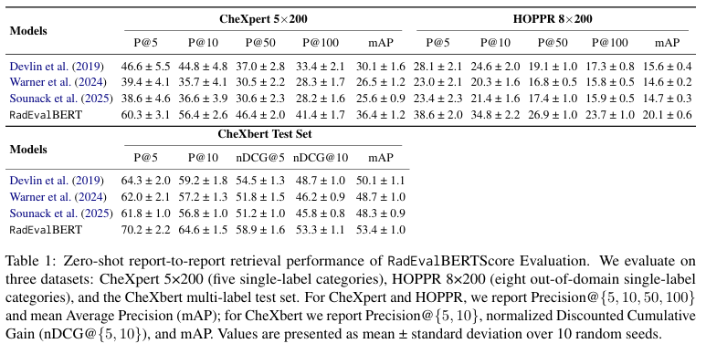
RadEvalBERTScore
RadEvalBERT retrieval performance
  RadEvalBERT wins every reported metric across all three retrieval datasets.
Notes:
This is Table from the paper. It compares RadEvalBERT with general BERT, ModernBERT, and BioClinical ModernBERT.
There are three evaluation datasets: CheXpert 5×200, HOPPR 8×200, and the CheXbert test set.
The main thing to notice is that RadEvalBERT obtains the highest result in every reported metric across all three datasets.
So we do not need to memorize every number. The important result is that radiology-specific contrastive training produces better report embeddings.

Slide 15
RadEvalBERTScore
What the retrieval results say
  Domain-specific radiology contrastive training produces better report embeddings than general BERT-style encoders.
CheXpert 5×200
RadEvalBERT has highest P@5, P@10, P@50, P@100, and mAАР. Best sign: strong in-domain single-label retrieval.
HOPPR 8×200
RadEvalBERT also wins on the out-of-domain set. Best sign: improved generalization beyond the training-style data.
CheXbert Test Se
RadEvalBERT wins P@5, P@10, nDCG@5, nDCG@10, and mAP. Best sign: better multi-label ranking.
Notes:
This slide summarizes Table.
On CheXpert, RadEvalBERT performs best on all Precision@K values and mAP.
It also performs best on HOPPR, which is important because HOPPR is out-of-domain, suggesting better generalization.
Finally, on the multi-label CheXbert test set, it also leads in Precision, nDCG, and mAP.
So the main conclusion is that the radiology-specific training produces better semantic representations than the compared general-purpose encoders.

Slide 16
RadEval Expert Dataset
Radiologists annotate error types and clinical significance.
  Errors include false findings, omissions, wrong location, wrong severity, spurious comparisons, missing prior-study change, and grammar/readability.
  Every error is labeled as clinically significant or insignificant.
  Candidate reports come from CheXagent, CheXpert-Plus, and MAIRA-2.
208 studies 148 Findings 60 Impressions
3 candidates per ground truth K=3
Radiologist error labels
624 candidate reports
Notes:
The next major contribution is the RadEval Expert Dataset.
The authors include 208 studies: 148 Findings cases and 60 Impression cases.
For each reference report, three AI-generated candidate reports are evaluated, giving a total of 624 candidate reports.
The candidates come from CheXagent, CheXpert-Plus, and MAIRA-2.
Board-certified radiologists annotate errors such as false findings, omitted findings, wrong location, wrong severity, incorrect comparisons, temporal mistakes, and grammar problems. Each error is also labeled as clinically significant or insignificant.

Slide 17
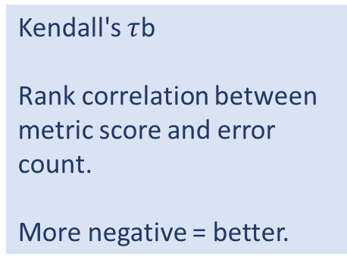
RadEval Expert Dataset
Methods: metric agreement with radiologists
  The expert study asks whether metric scores move opposite to radiologist error counts.
  Labels used in Table
  Higher metric score should mean fewer significant radiologist errors.
Kendall's $τ$b
Rank correlation between metric score and error count.
More negative = better.
Pooled analysis
Treats each candidate independently.
Ignores study grouping.
Blocked analysis
Compares candidates within the same study.
Tie-aware + bootstrap CI.
✓ aligned: CI < 0
X misaligned: CI > 0
ns: CI crosses 0
Notes:
Now the authors want to know whether automatic metric scores actually agree with radiologist judgments.
They use Kendall's tau-b, which is a rank correlation measure.
Here, a more negative correlation is better, because we expect a higher metric score to correspond to fewer radiologist errors.
They perform two analyses. The pooled analysis treats every candidate independently. The blocked analysis compares the three candidate reports within the same study.
A result is marked aligned when the confidence interval is entirely below zero, misaligned when it is above zero, and not significant when it crosses zero.

Slide 18
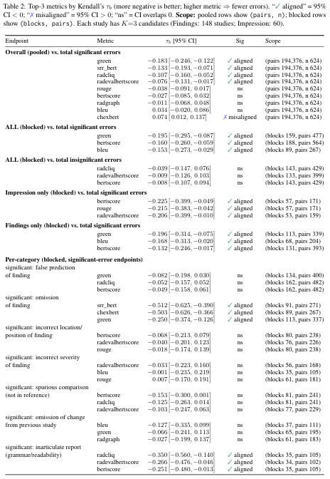
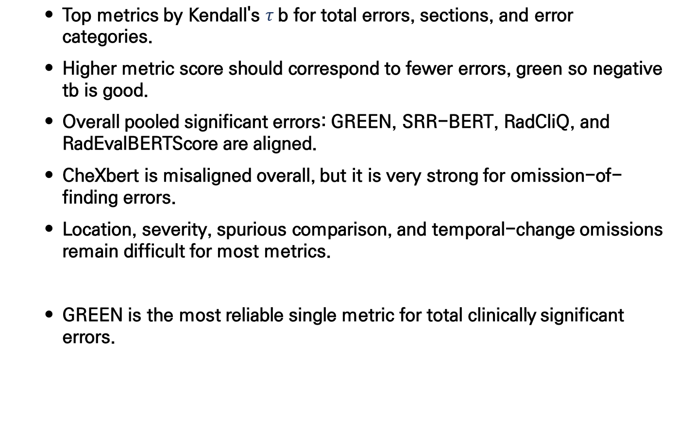
RadEval Expert Dataset
Correlation with radiologist error counts
  Top metrics by Kendall's $τ$b for total errors, sections, and error categories.
  Higher metric score should correspond to fewer errors, green so negative tb is good.
  Overall pooled significant errors: GREEN, SRR-BERT, RadCliQ, and RadEvalBERTScore are aligned.
  CheXbert is misaligned overall, but it is very strong for omission-of-finding errors.
  Location, severity, spurious comparison, and temporal-change omissions remain difficult for most metrics.
  GREEN is the most reliable single metric for total clinically significant errors.
Notes:
This is one of the most important tables in the paper.
For overall clinically significant errors, GREEN has the strongest negative correlation, followed by SRR-BERT, RadCliQ, and RadEvalBERTScore.
Interestingly, CheXbert is misaligned overall. However, when we look specifically at omission of findings, CheXbert and SRR-BERT perform extremely well.
Another important observation is that location, severity, spurious comparisons, and temporal-change omissions remain difficult for most metrics.
Therefore, the authors conclude that GREEN is the most reliable single metric overall, but no metric handles every error category equally well.

Slide 19
RadEval Expert Dataset
What each metric is good at
  No metric wins everywhere, and category-level behavior matters.
  A metric can be weak overall but excellent for one specific error type, and vice versa.
Endpoint | Best signal | Result
Overall significant errors | GREEN | Aligned
Finding omissions | SRR-BERT / CheXbert | Strongly aligned
Impression section | BERTScore | Aligned
Findings section | GREEN | Aligned
Grammar / readability | RadCliQ | Aligned
Location / severity / temporal categories | No reliable winner | Mostly ns
Notes:
This slide simplifies the previous table.
GREEN performs best overall for clinically significant errors and also performs well for Findings.
SRR-BERT and CheXbert are especially strong for missing findings.
BERTScore performs strongly for the Impression section.
RadCliQ performs best for grammar and readability errors.
But for location, severity, and temporal errors, there is no consistently reliable winner.
So the key message is: a metric can be weak overall but very useful for a specific error type.

Slide 20
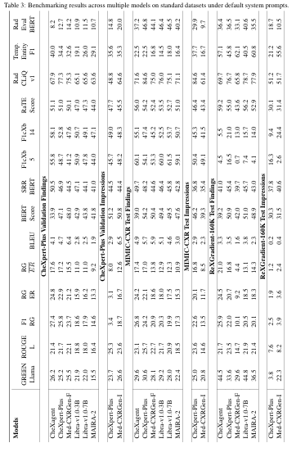
Benchmarking
Benchmarking models across datasets
  Full table: multiple models, multiple datasets, multiple metric families
Notes:
This Table is the full model benchmarking result.
The rows are different report-generation models and the columns are the different RadEval metrics.
Results are presented separately for CheXpert-Plus, MIMIC-CXR, and ReXGradient, and separately for Findings and Impression.
I would not focus on individual numbers here. The main observation is that different metrics often rank the same models differently.

Slide 21
Benchmarking
The table demonstrates why one metric is not enough.
  Dataset matters: A model can look strong on MIMIC-CXR but weaker on ReXGradient or CheXpert-Plus.
  Section matters: Findings and Impression are separate tasks and should be evaluated separately.
  Metric matters: GREEN, BLEU, CheXbert, RadGraph, Temporal F1, and RadEvalBERT often rank models differently.
  Benchmarking matters: RadEval lets researchers compare the same predictions using a wider metric dashboard.
Notes:
The previous Table demonstrates why relying on one metric can be misleading.
First, dataset matters. A model that performs well on MIMIC-CXR may perform differently on ReXGradient.
Second, report section matters, because Findings and Impression are different generation tasks.
Third, metric choice matters, because GREEN, BLEU, CheXbert, RadGraph, and temporal metrics can produce different rankings.
This is exactly the motivation for having a framework like RadEval with multiple complementary metrics.

Slide 22
Appendix
Refined GREEN metric
  The authors make GREEN smaller, faster, and broader across modalities.
  Authors tries to preserve interpretability and clinical alignment while reducing computational cost.
Original GREEN
LLM-based report evaluation Mainly chest X-ray focused
Fine-tuning
Gemma-2B + original GREEN data + 50,000 annotated report pairs
Refined GREEN
CT, MRI, ultrasound 2-3 sec/report Comparable to larger models
Notes:
The authors also improve the GREEN metric.
The original GREEN was mainly focused on chest X-ray report evaluation. In RadEval, they fine-tune a smaller Gemma-2B model using the original GREEN data plus 50,000 additional annotated radiology report pairs.
These additional reports include multiple modalities such as CT, MRI, and ultrasound.
The refined model takes around 2 to 3 seconds per report while maintaining performance comparable to larger models.
So the main benefit is that GREEN becomes smaller, faster, and more broadly applicable.

Slide 23
Conclusion & Limitation
Conclusion
  RadEval unifies multiple radiology report evaluation metrics in one open-source and standardized framework.
  RadEvalBERT and the expert-annotated dataset strengthen semantic evaluation and comparison with radiologist judgments.
  GREEN showed the strongest overall alignment with clinically significant errors, supporting more reliable RRG evaluation
Limitationss
  Not all recent LLM metrics included CheXprompt, FineRadScore, and RadFact are not implemented in the paper version.
  Parser dependency: Some metrics depend on upstream extractors/parsers, which can add noise.
  Generalization limits: Focus is mainly English chest X-ray reports from U.S. institutions.
  Expert dataset size: More reports and more annotators are needed for stronger analysis.
Notes:
To conclude, RadEval provides a unified and open-source framework for evaluating radiology report generation using many complementary metrics.
The authors also contribute RadEvalBERT and an expert-annotated dataset for evaluating how well automatic metrics agree with radiologists.
Among the tested metrics, GREEN showed the strongest overall alignment with clinically significant errors.
However, there are several limitations. Some recent LLM metrics such as CheXprompt, FineRadScore, and RadFact were not implemented in the paper version.
Some metrics depend on upstream parsers, so parser errors can influence evaluation.
The experiments mainly focus on English chest X-ray reports from U.S. institutions, so generalization is limited.
Finally, the expert dataset is still relatively small and could benefit from more reports and more radiologist annotators.

